Slide 1
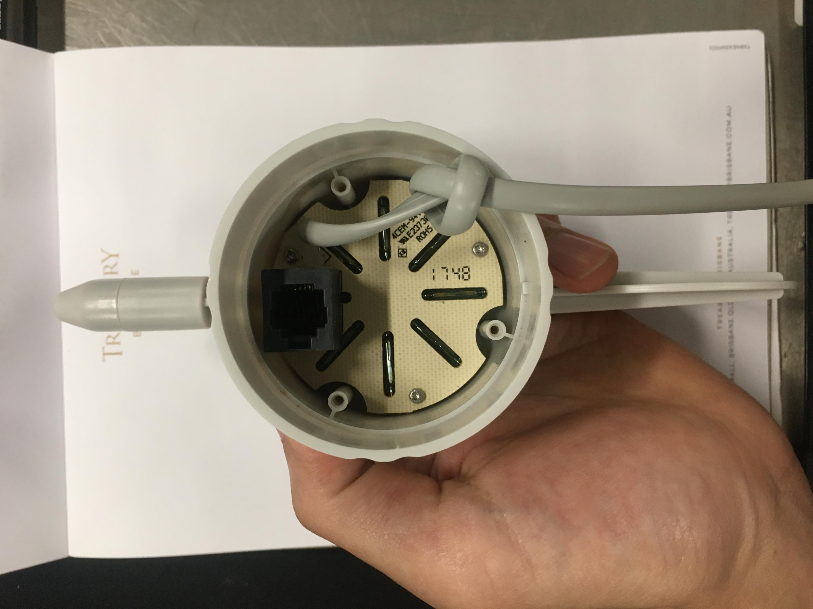
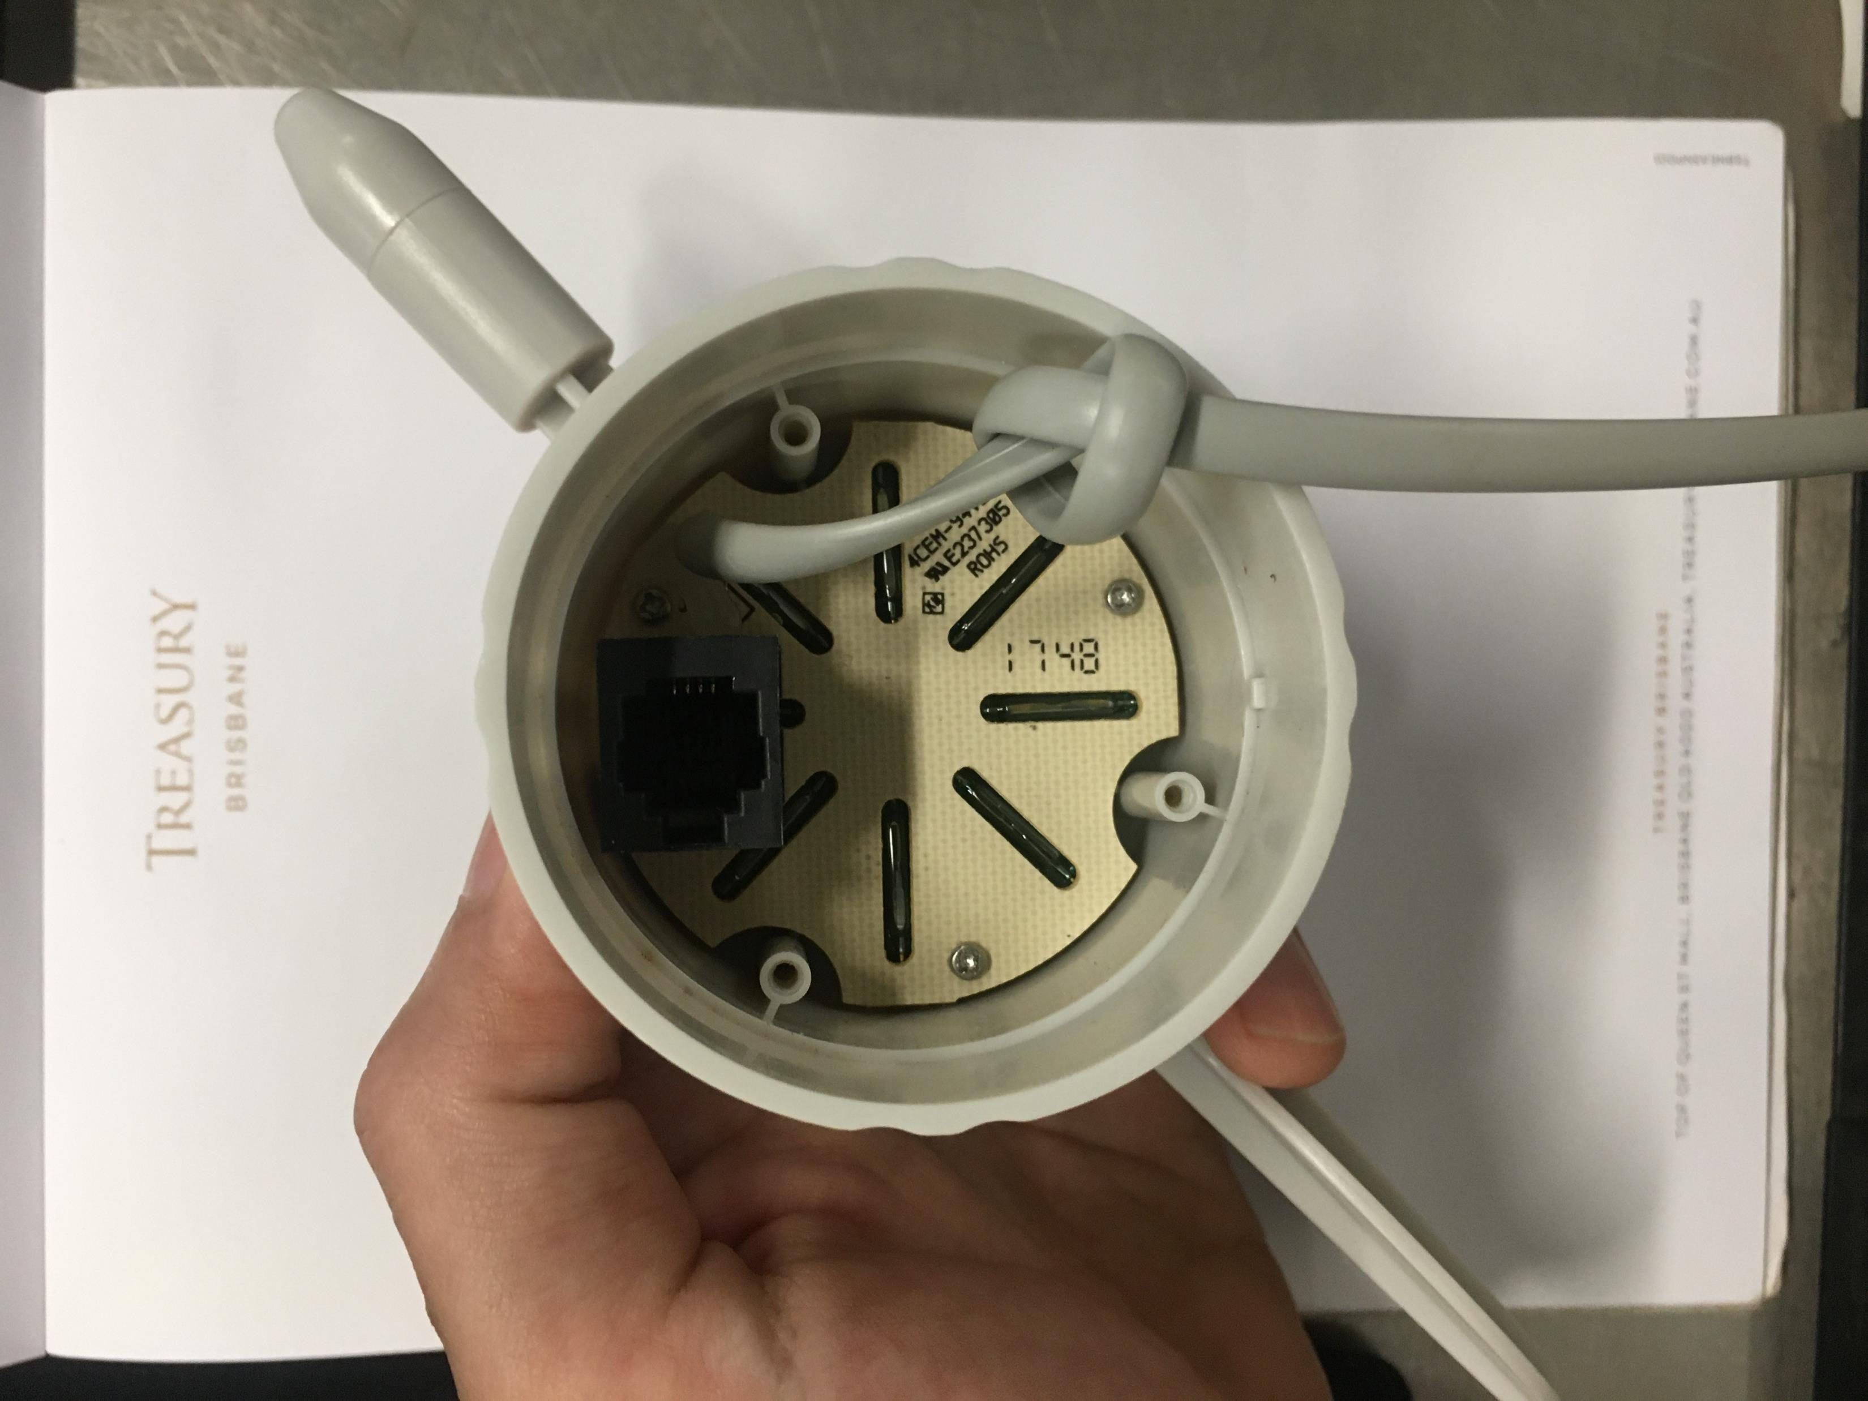
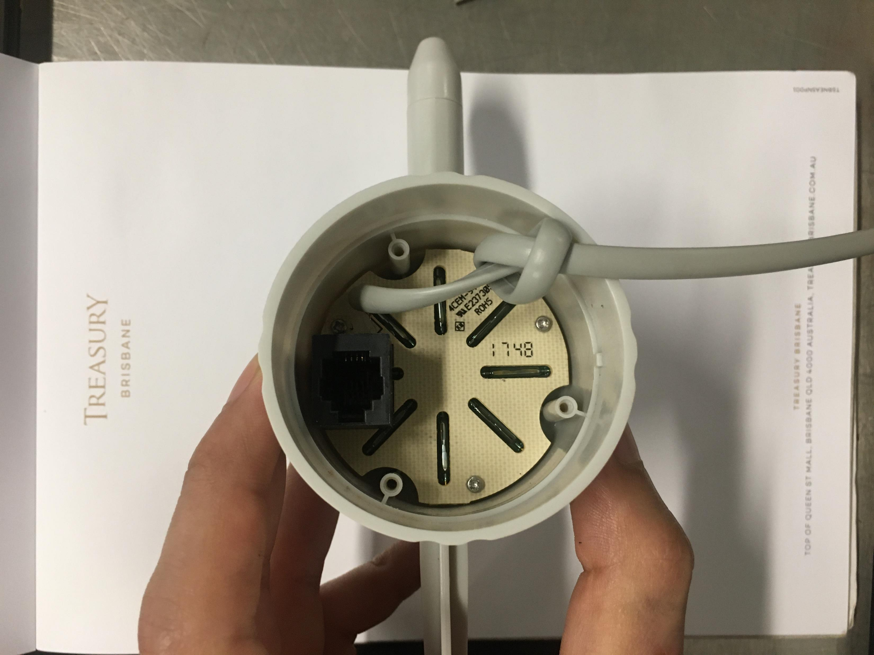
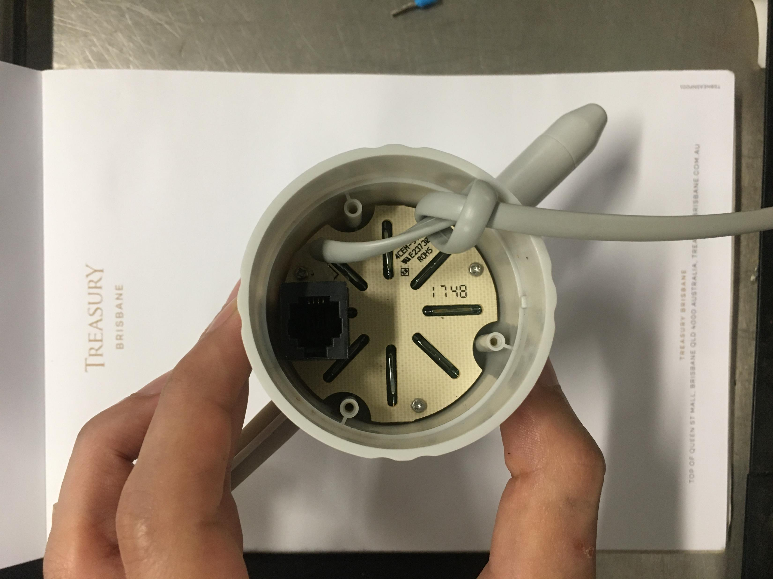
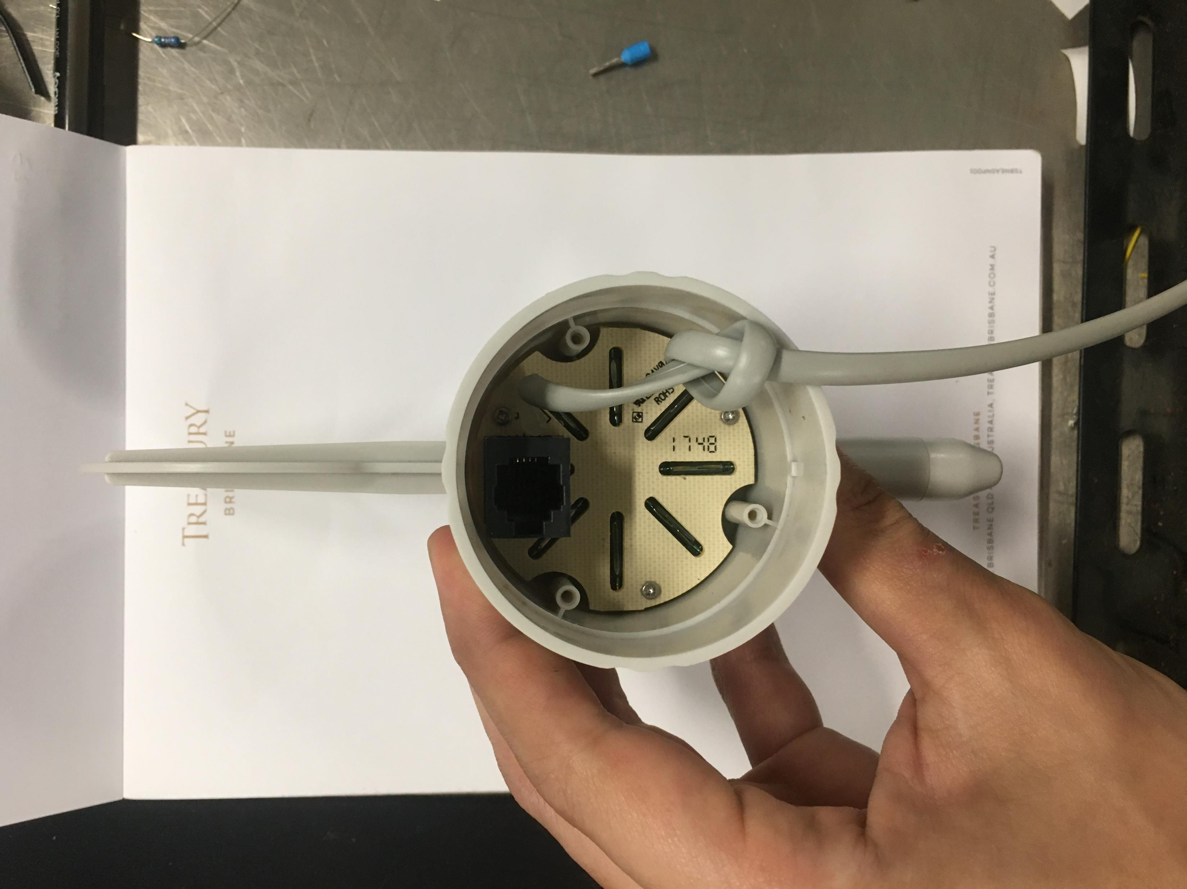

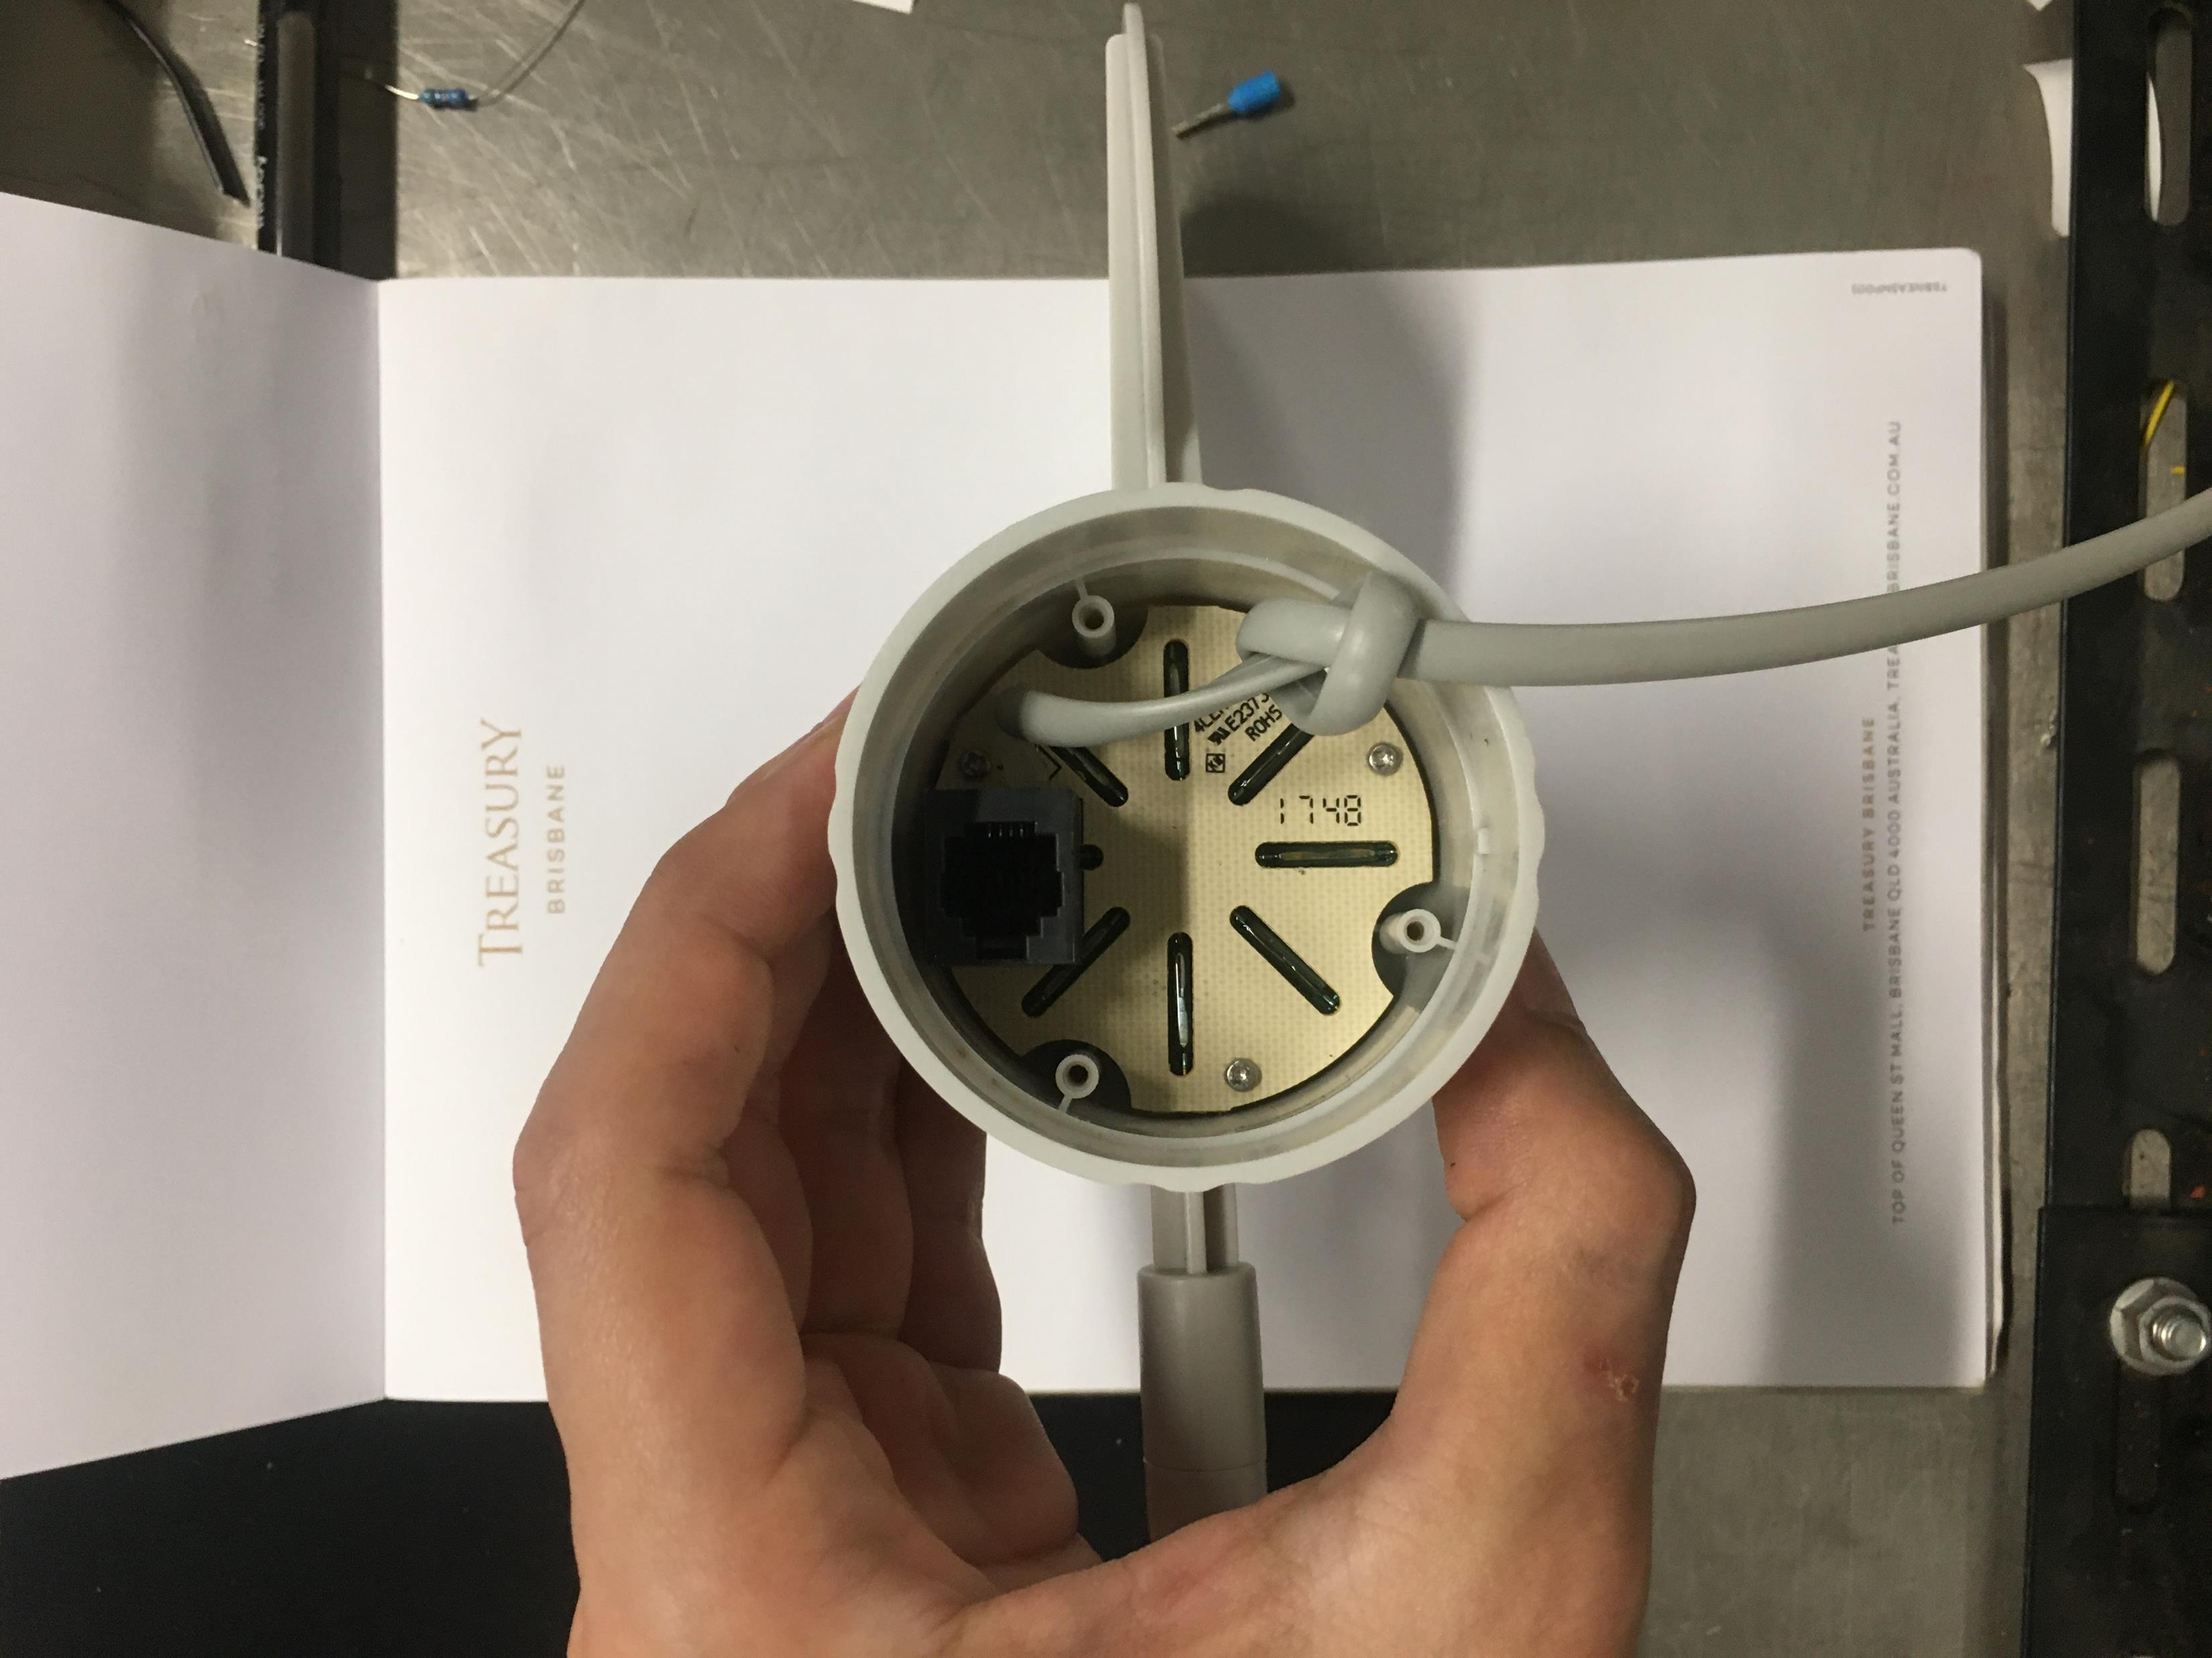
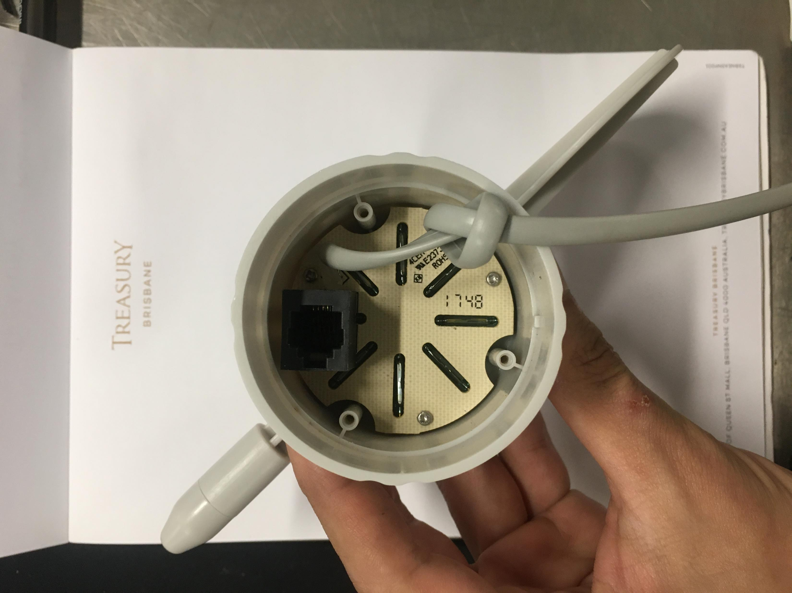
Output value for different directions
758
956
1023
522
181
107
50
330
Resistor: 24k (must be larger than this value, otherwise there will be two or more directions have the same output of 1023.
A reference direction must be given. We can let RJ11 socket point to the North, and we will have the following output values for each direction:
These are averaged values. In practice, an output reading will not be the exact same as these values.
Direction | N | N-E | E | S-E | S | S-W | W | N-W
Output | 758 | 956 | 1023 | 522 | 181 | 107 | 50 | 330

Slide 2
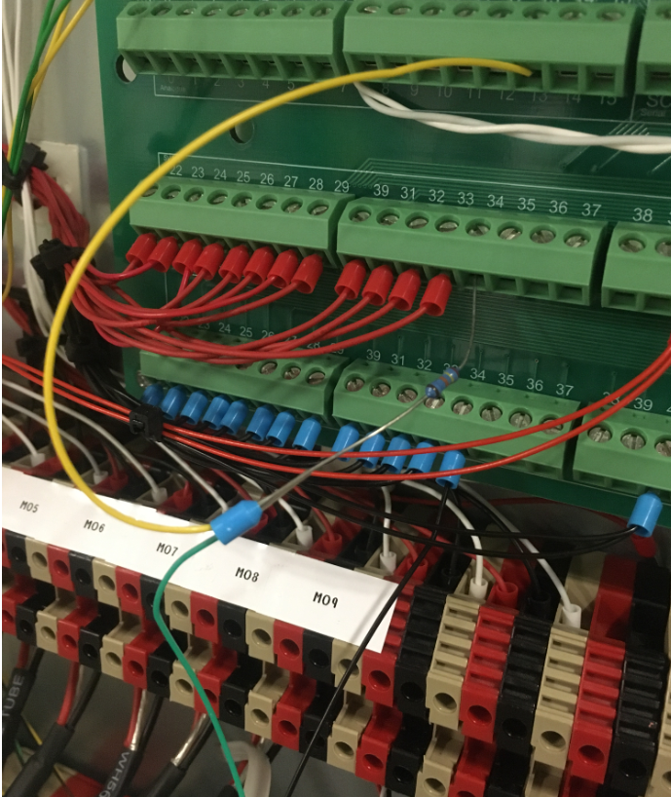
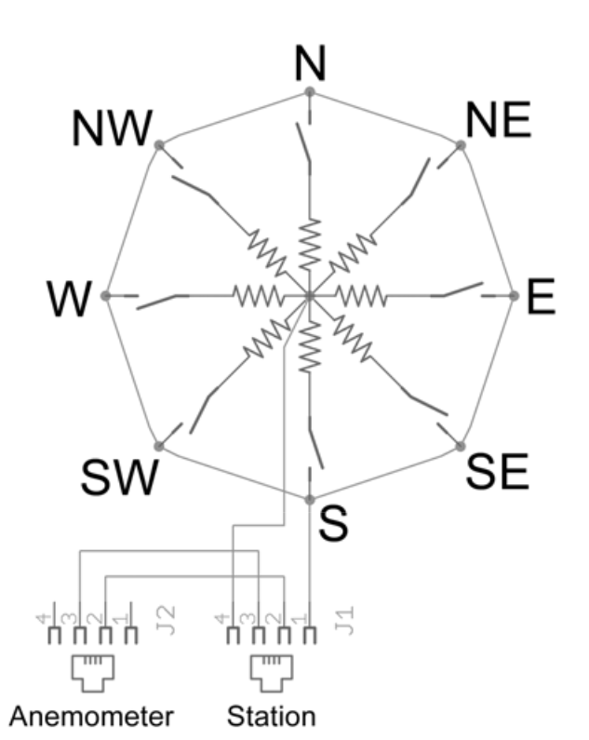
Circuit and Wiring
Resistor
Arduino Analog
Arduino 5V_HS
24K Resistor
Pi GPIO
Pi GND
Arduino 5V_LS

